Slide 1
Python Review
Adv. Python Programming – Module 1

Slide 2
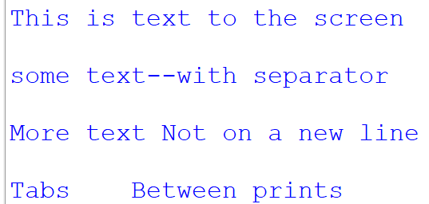
Output
Output is any form of displaying information
On a screen using the print()
In a text file
On a piece of paper from a printer
For printing to the console, we use the print() function
print() function has some adjustability
define the ‘sep’ property for what character to print when a comma is used – default is a space
define the ‘end’ property for what character to print after everything – default is a new line ‘\n’
Escape Sequences
Insert these into any string to modify text
\n – new line
\t – tab
\” – print a double quote
\’ – print a single quote
\\ - print the backslash itself – like windows file systems
print("This is text to the screen")
print()
print("some text", "with separator", sep="--")
print()
print("More text ", end="")
print("Not on a new line")
print()
print("Tabs", end="\t")
print("Between prints")

Slide 3
Variables
Variables are named spaces to store data
To create a variable, you simply type the name you want to use for the variable
Use the assignment operator ‘=‘ to assign a value to the variable
The variable name should be meaningful to the data it holds
first_name
last_name
age
etc.
Variables should be named underscores between words – PEP8
first_name or firstName
last_name or lastName
pi = 3.14
first_name = "Tony“
last_name = "Stark"
num_of_love_yous = 3000

Slide 4
Input and Casting
To get console-based input from the keyboard you need to use the input() function
The input() allows for a text prompt to be put in that prints out
That input() function should be assigned to variable to store for use in a program
The data from input() comes in text form, sometimes you need it in other forms like an integer(whole number) or float (decimals/fraction number)
int(value)
float(value)
For this we have to cast the input/variable.
This can be done with the input() or after the fact
input("Enter your first name: ") # doesn’t save values
input("Enter your last name: ")
first_name = input("Enter your first name: ") #saves to var
last_name = input("Enter your last name: ")
how_much_love = int(input("How much do you love me? "))
rain = float(input("Enter rainfall: "))
age = input("Enter age: ")
age = int(age)

Slide 5
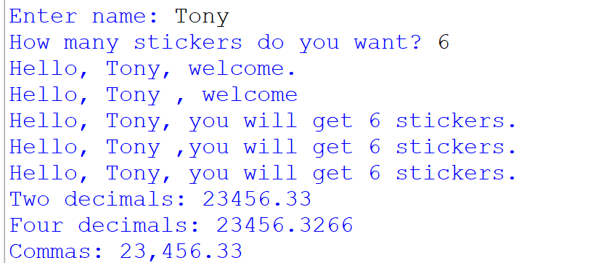
Displaying variables
There are several ways to print out variables combine with text
Concatenation using the “+” operator
If you are combining text and numbers you must cast variables to string using str() otherwise an error occurs
Using the separator ‘,’ between elements in print()
By default, adds spacing. Do you want spacing? You have to constantly modify sep value in prints
Using f-strings to easier and more controlled format
great for controlling decimal places and combining several variables – quick and easy
name = input("Enter name: ")
sticker_count = int(input("How many stickers do you want? "))
print("Hello, " + name + ", welcome.")
print("Hello,", name, ", welcome")
print("Hello, " + name + ", you will get " + str(stickerCount) + " stickers.")
print("Hello,", name, ",you will get", stickerCount, "stickers.")
print(f"Hello, {name}, you will get {stickerCount} stickers.")
number = 23456.326589
print(f"Two decimals: {number:.2f}")
print(f"Four decimals: {number:.4f}")
print(f"Commas: {number:,.2f}")

Slide 6
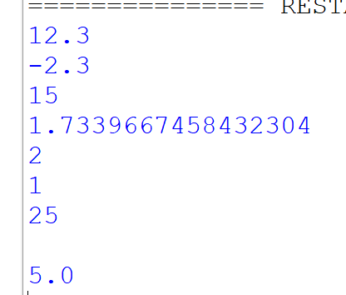
Math Operations
Use the following to perform math operations
+ to add
- to subtract
* to multiply
/ for division
// for integer division (no decimals)
% for modulus division (get the remainder)
** for exponentiation
We also have the math module that has built in functions (more on this in Module 02)
import math
math.pi
math.sqrt()
etc.
num1 = 5
num2 = 7.3
add = num1 + num2
sub = num1 - num2
multiply = num1 * 3
divide = num2 / 4.21
whole_div = num1 // 2
mod_div = num1 % 2
exp = num1 ** 2
import math
root = math.sqrt(exp)

Slide 7
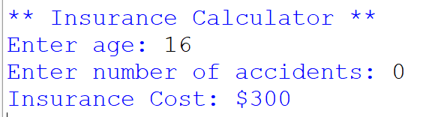
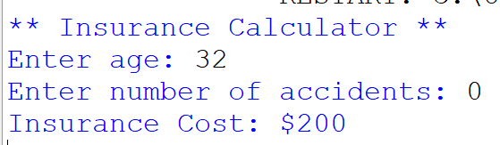
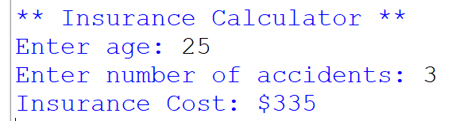
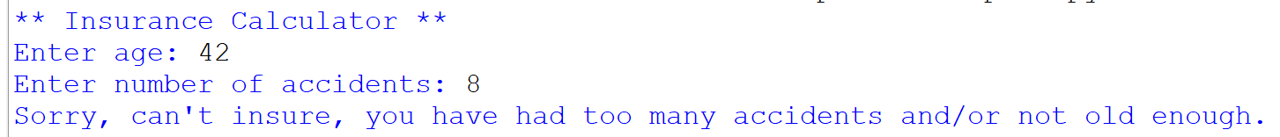
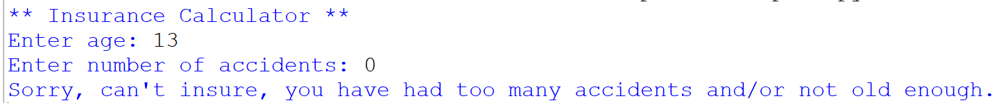
Conditionals – if/else
grade = input("Enter letter grade: ")
if grade == "A" or grade == "a":
print("100%")
elif grade == "B" or grade == "b":
print("90%")
elif grade == "C" or grade == "c":
print("80%")
elif grade == "D" or grade == "d":
print("70%")
elif grade == "F" or grade == "f":
print("50%")
else:
print("Error, no matching grade")
---------------------------------------------------
print("** Insurance Calculator **")
insurance = 200 # starting value
age = int(input("Enter age: "))
accidents = int(input("Enter number of accidents: "))
if accidents < 6 and age >= 15:
if age < 19:
insurance += 100 # due to age, higher insurance
insurance += accidents * 45 # add $45 per accident charge
print(f"Insurance Cost: ${insurance}")
else:
print("Sorry, can't insure, you have " + \
"had too many accidents and/or not old enough.")
To help us control the functionality of our program we use conditionals.
if – elif – else
Conditionals use Boolean expressions that if solved out to True will run the code
Boolean expressions us relational operators and logical operators
>, >=, <, <=, ==, !=
and, or, not
Remember to have a colon at the end and all lines of code tabbed in that you want to run in the condition
elif and else aren’t required
You can have as many elif as you want
Remember else doesn’t need a Boolean expression
else is always tied to the closest if

Slide 8
Coding Example – Simple Calculator
Let’s put our skills to the test.
I want to make a simple calculator to enter some numbers, pick a math operation and produce the results.
We can discuss different features/options to code

Slide 9
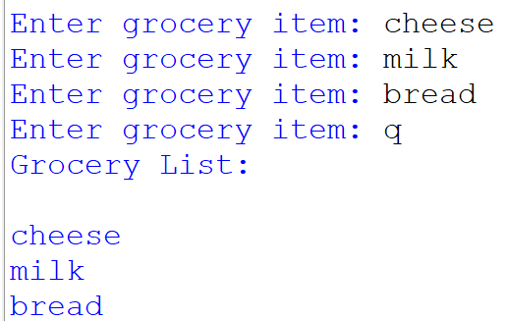
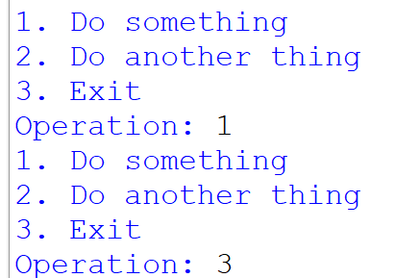
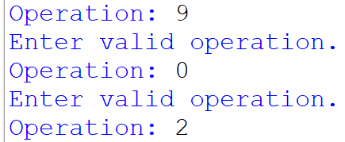
While Loops
i = 0
while i < 10:
print(i)
i += 1
grocery_list = ""
while True:
item = input("Enter grocery item: ")
if item == "Q" or item == "q":
break
grocery_list += "\n" + item
print("Grocery List: \n" + groceryList)
choice = 0 # prime input to run loop
while choice != 3:
print("1. Do something")
print("2. Do another thing")
print("3. Exit")
choice = int(input("Operation: "))
#.... code for if/else if ....
choice = int(input("Operation: "))
while choice < 1 or choice > 3:
print("Enter valid operation.")
choice = int(input("Operation: "))
When we want to repeat code we use loops
while – indefinite loop – unknown how many times it will run
Great for repeating our console programs
Checking for input validation
Doing math on variables until a value is reached
At the end of defining a loop you need a colon and all lines tabbed in underneath to run within
we also have ‘break’ and ‘continue’ keywords to help with specific operations
Number one error, not modifying the variable you are using in the while Boolean check, inside of the while loop
Make sure to get input from user AGAIN
Do math to a variable.

Slide 10
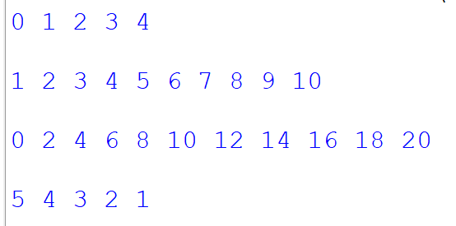
For Loops
When we want to repeat code we use loops
for – definite loop – set amount of times to run
Loop through a range of numbers/times based on input
Loop through a collection (like a list) of items and perform action with/on them
loops usually use the range()(for numbers) and a variable with ‘in’ operator
At the end of defining a loop you need a colon and all lines tabbed in underneath to run within
we also have ‘break’ and ‘continue’ keywords to help with specific operations
for i in range(5):
print(i, end=" ")
print()
print()
for i in range(1, 11):
print(i, end=" ")
print()
print()
for i in range(0, 21, 2):
print(i, end=" ")
print()
print()
for i in range(5, 0, -1):
print(i, end=" ")
print()
print()

Slide 11
Functions
Functions are great if we have some code or operation that repeats throughout out program or to make our code easier to read
We make it generic and wrap the code in its own defined namespace to call
We use the ‘def’ followed by the name of the function, then parenthesis and a colon
just like with variables, the name of the function should reflect what it does
The parenthesis allow us to define variables to use in the function that gets assigned values when we call the function in our code – parameters
All lines of code should be tabbed in underneath that will run in the function
Functions should do one thing
Functions can return a value
Or Functions don’t return anything (void)
Industry standard to have a main() function and call it check the __name__ property
See example code
def add(a, b):
return a + b
def add_print(a, b):
print (a+b)
def main():
add_print(4, 2)
math = add(4, 2)
print(math)
if __name__ == "__main__":
main()

Slide 12
Coding Example – Simple Calc better
Now we know about looping and some functions.
Let’s take our Simple Calculator and apply these concepts.
while loop
check input values
move calculations to functions
We will use for loops more coming up….

Slide 13
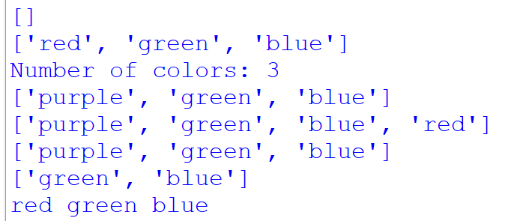
Lists
colors = []
print(colors)
colors = ["red", "green", "blue"]
print(colors)
print("Number of colors:", len(colors))
colors[0] = "purple"
print(colors)
colors.append("red")
print(colors)
colors.remove("red")
print(colors)
del(colors[0])
print(colors)
colors = ["red", "green", "blue"]
for c in colors:
print(c, end=" ")
print()
When you want to have a variable that stores a bunch of data separated by entries, lists are great – things stay in a set order
They have elements that are stored at index locations
the first index is 0
the last index is the length (num of elements) – 1
You can use negative index to access last elements
You access elements using the square brackets [ ]
You can use for loops go through a list
Lists elements can be of different data types
Use functions like append(), remove(), del() and len() on a list

Slide 14
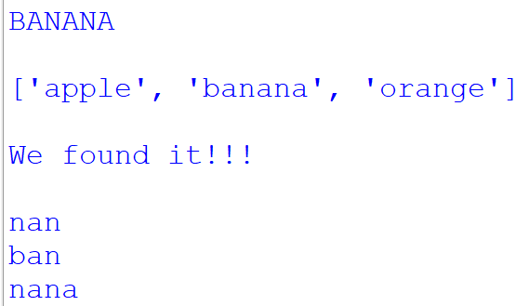
Strings and their methods
“methods” is a function that is part of an object – so a function that you do on a String
All data in a program starts out as a string, we then convert it, manipulate it, split it, etc as needed
Because of this we have a bunch of built in functions to help us handle strings
lower() and upper()
.strip()
.replace()
.split()
Use the “in” keyword to check substring exists
Use square brackets to create substrings [start:end]
fruit = "banana"
upper = fruit.upper()
print(upper)
print()
fruits = "apple banana orange"
f_Split = fruits.split(" ") # returns a list
print(f_split)
print()
if "an" in fruit:
print("We found it!!!")
print()
sub = fruit[2:5]
begin_sub = fruit[:3]
end_sub = fruit[2:]
print(sub)
print(begin_sub)
print(end_sub)

Slide 15
Coding Example – Grocery List with Lists
Let’s make a program that we can make a grocery list
Add to it
Delete from it
Exit out

Slide 16
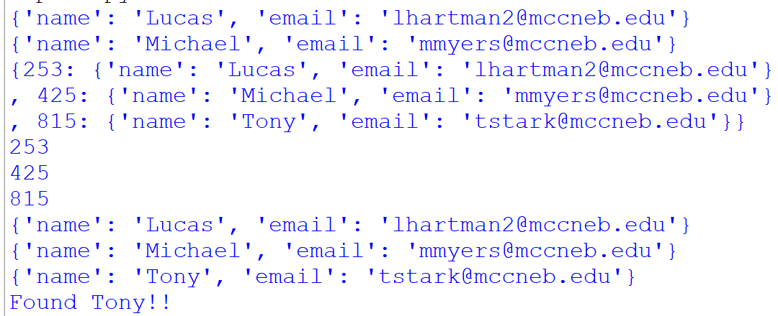
Dictionaries
user1 = {"name" : "Lucas", "email" : "lhartman@mccneb.edu"}
user2 = {"name" : "Michael", "email" : "mmyers@mccneb.edu"}
user1["email"] = "lhartman2@mccneb.edu"
print(user1)
print(user2)
users = {}
users[253] = {"name" : "Lucas", "email" : "lhartman@mccneb.edu"}
users[425] = {"name" : "Michael", "email" : "mmyers@mccneb.edu"}
users[815] = {"name" : "Tony", "email" : "tstark@mccneb.edu"}
user = users.get(253)
if user:
user["email"] = "lhartman2@mccneb.edu"
print(users)
for key in users:
print(key)
for key in users:
print (users[key])
for key in users:
if users[key]["name"] == "Tony":
print("Found Tony!!")
Dictionaries are similar to a list but they aren’t in any set order, they are just stored as key-value pairs
The key can be any type – string, number, etc. – but used to find the data, like an index
The value is any data
When adding elements you simply use the [ ] to add the value store at the key location
Be careful as you can only have one key per dictionary so if you think you are adding but the key already exists, you are overwriting data
Use the “in” operator to check if a key is already in a dictionary
You use the square brackets [] to access the data or the get() function
[ ] can throw error if key doesn’t exist – so be careful, use the in operator
get() will not throw an exception and instead return a default value if doesn’t exist

Slide 17
Coding Example – Grocery List with Dict
Let’s do the same thing for our grocery list system, except use dictionaries
Add to
View
Delete from
Quantity of item?
List of dictionaries for each item?

Slide 18
Debugging in an IDE
Adv. Python Programming

Slide 19

What is debugging?
Debugging helps you watch your code execute step-by-step instead of guessing where it fails
It lets you see variable values in real time, find logical errors and confirm code flow
Thing of it as slow motion mode for your program
To debug you must set breakpoints by clicking next to a line number
Breakpoints pause your program at a specific line before it executes
Inspect variables
Verify that a loop or condition runs as expected
Stop before an error occurs

Slide 20
Common Debugger Controls
Continue(Resume) – Runs the program until the next breakpoint.
Step Over – Executes the current line without entering functions.
Step Into – Jumps into the function being called to debug its code line-by-line.
Step Out – Runs the rest of the current function and returns to the caller.
Stop/Terminate – Ends debugging immediately.
Restart – Restarts the program from the beginning
Notes:
line 6 – inside view_list – step through checking list length
line16 – start of the input loop in get_item_input()
line 24 – start of add_item
line 32 – start of grocery list create – check the clearing of the list
line 39 – inside shop list loop
line 50 – start of main
line 64 – inside each menu branch

